Slide 1
ICS 474 Project Report Term: 241 Dataset: Credit Card Transactions
Here is where your presentation begins

Slide 2

Our team
Student : Mamdouh Almatrafi
ID: 202043260
Student : Hamza Alnour Abdallah
ID : 202044820
Student : Ahmed Alsayed
ID: 202045040

Slide 3
Table of contents
01
Data Understanding and Exploration
02
Data Preprocessing
03
04
Data Modeling
Visualization

Slide 4
01
Data Understanding and Exploration

Slide 5
Data Understanding and Exploration
Dataset Overview:
The chosen dataset is credit card Transactions.
The goal of this dataset is to collect a large number of detailed records related to credit card purchases such as transaction time, payment amounts and so on.
Hugging Face was the source that dataset was coming from.
The dataset is used for:
Fraud Detection
Customer Segmentation
Transaction Classification

Slide 6
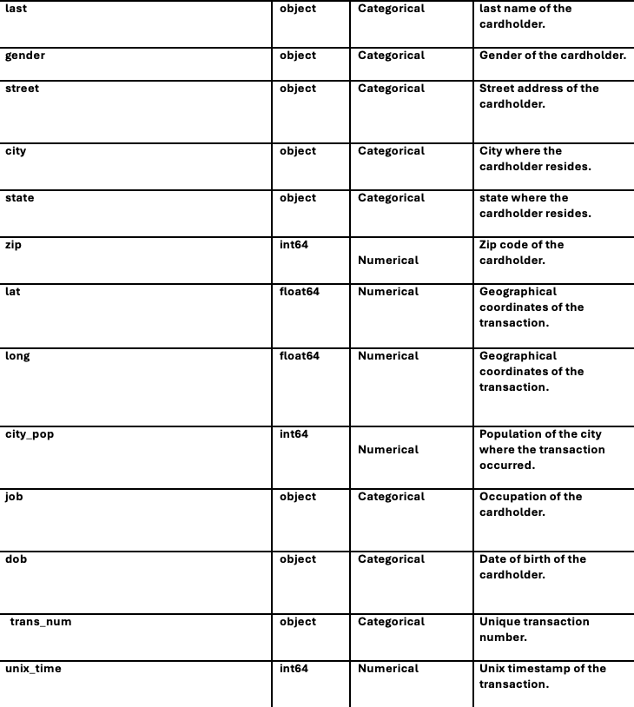
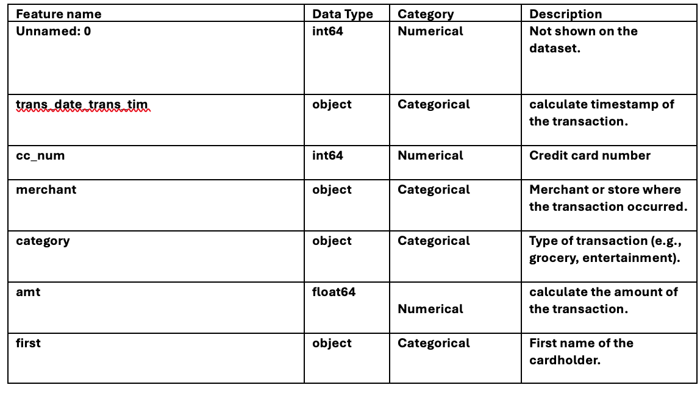
Data Understanding and Exploration
Feature Description :

Slide 7
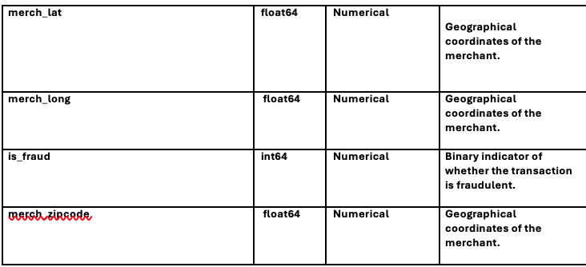
Data Understanding and Exploration
Feature Description :

Slide 8
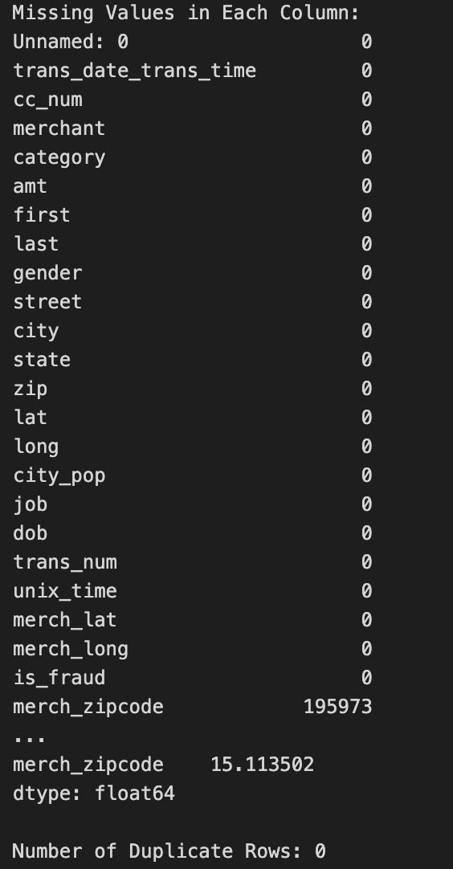
Data Understanding and Exploration
Dataset Structure:
The dataset contains 1296675 rows, 24 columns and 31120200 elements.
Missing Values and Duplicates:

Slide 9
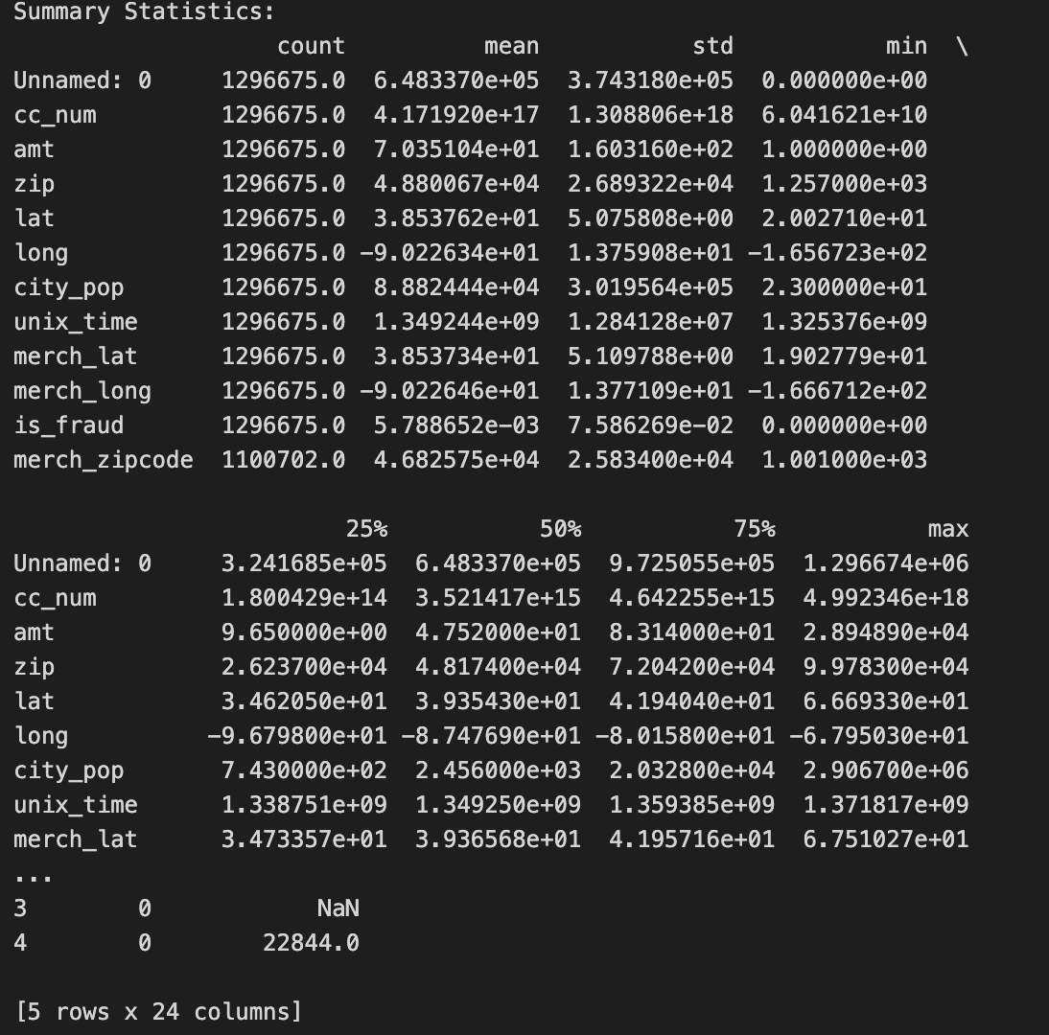
Data Understanding and Exploration
Statistical Summary:

Slide 10
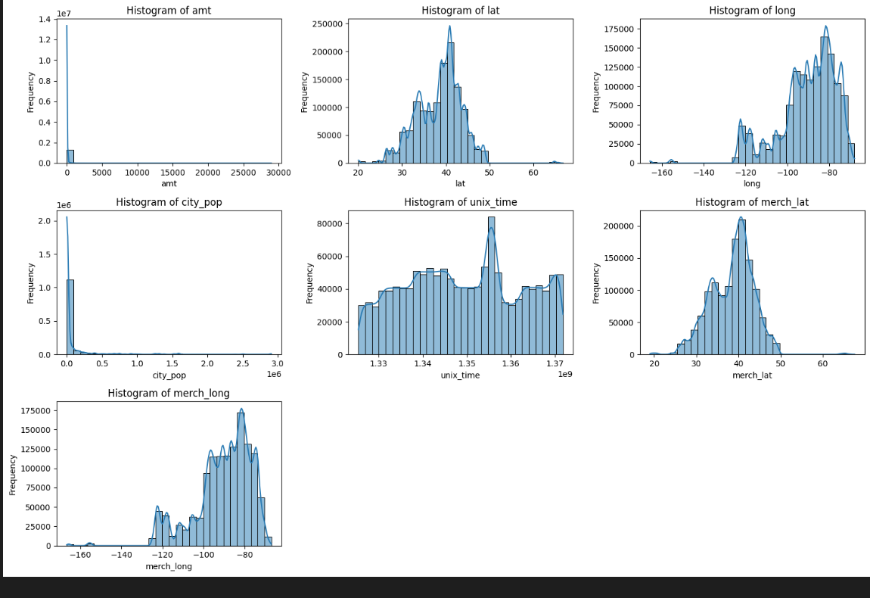
Data Visualization and Understanding
Data Distribution:

Slide 11
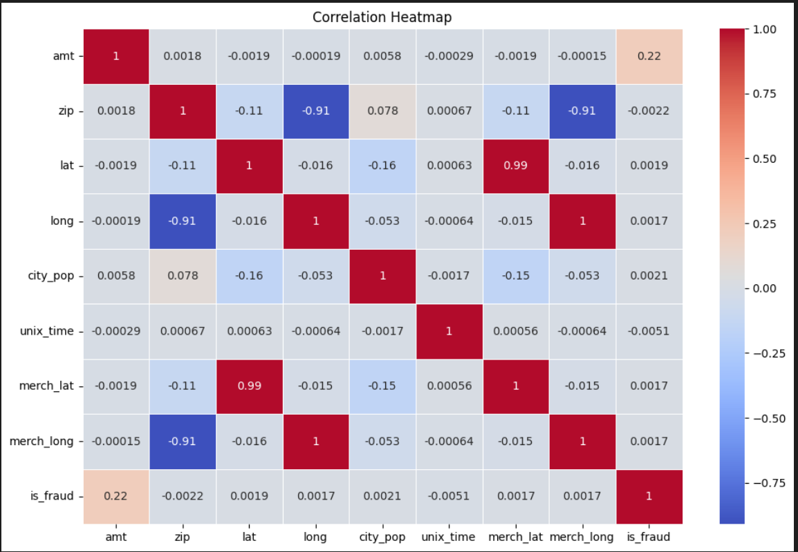
Data Visualization and Understanding
Correlation Analysis:

Slide 12
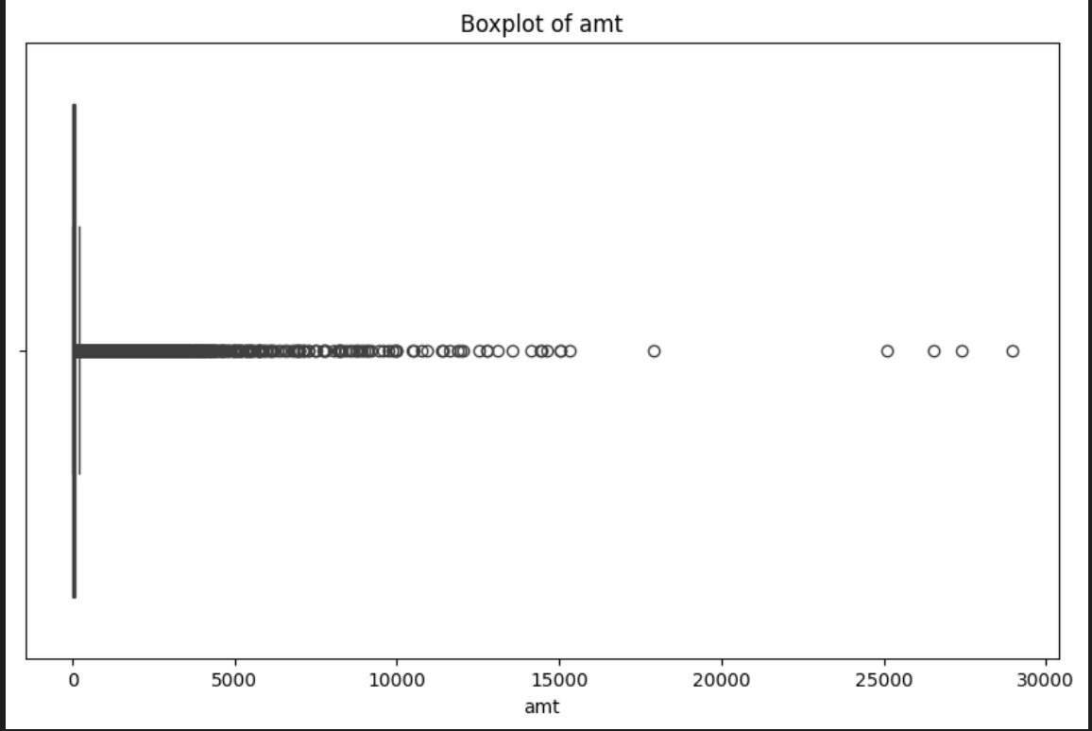
Data Visualization and Understanding
Outlier Detection:

Slide 13
02
Data Preprocessing

Slide 14
Data Preprocessing
Data Preprocessing Overview:
Importance of Data Preprocessing.
Key Steps:
Cleaning,
Encoding
Scaling
Selection
Objective: Prepare Data for Accurate Modeling.

Slide 15
Data Preprocessing
Cleaning and Encoding Data:
Handling Missing Data:
Strategy: Removal of merch_zipcode
Justification: Low relevance and high distortion risk
Encoding Categorical Variables:
Technique: Label Encoding

Slide 16
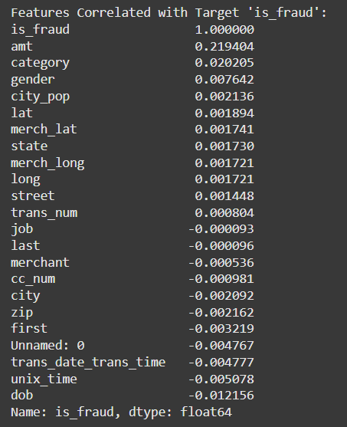
Data Preprocessing
Scaling and Feature Selection:
Feature Scaling:
Standard Scaling to Normalize Distribution.
Excluded Target (is_fraud).
Feature Selection:
Correlation with Target Variable.

Slide 17
03
Data Modeling

Slide 18
Data Modeling
Algorithm Selection:
Classification:
Logistic Regression and Decision Trees: Good for interpretability and fast training.
Random Forest and XGBoost: Effective for handling imbalanced datasets common in fraud detection.
Neural Networks: Suitable for large datasets with complex patterns but require careful tuning.
Clustering:
K-Means: Useful for grouping similar transaction patterns but sensitive to initial clustering.
DBSCAN: Handles varying densities, useful for anomaly detection in high-dimensional data​.

Slide 19
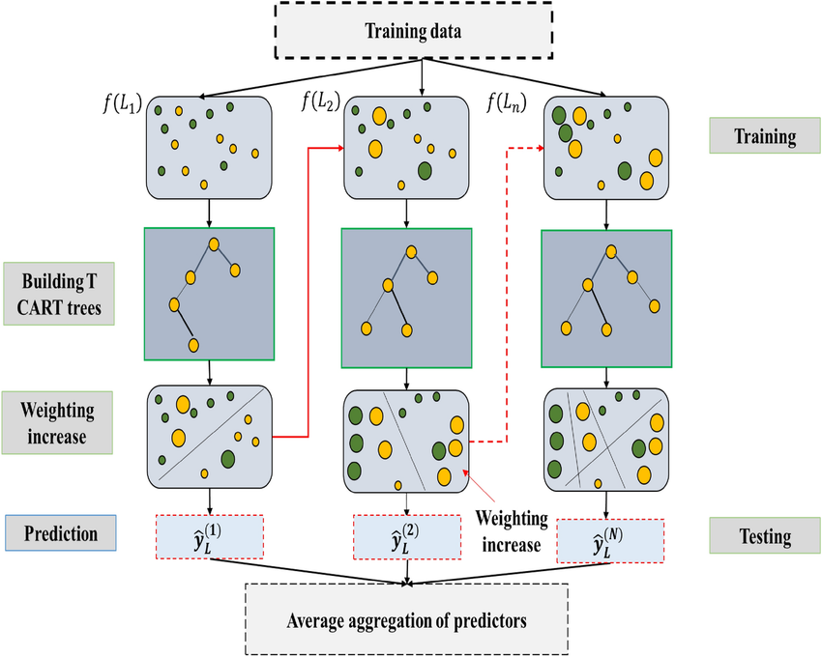
XGBoost:

Slide 20
Data Modeling
Aspect | XGBoost | Random Forest | Logistic Regression
Type | Ensemble, Boosting | Ensemble, Begging | Linear Model
Speed | Very Fast | Moderate | Very Fast
Overfitting Control | Strong | Moderate | Weak
Feature Handling | Numeric & Categorical | Numeric & Categorical | Numeric Only
Interpretability | Complex | Moderate | Easy
Performance | High | High | Moderate

Slide 21
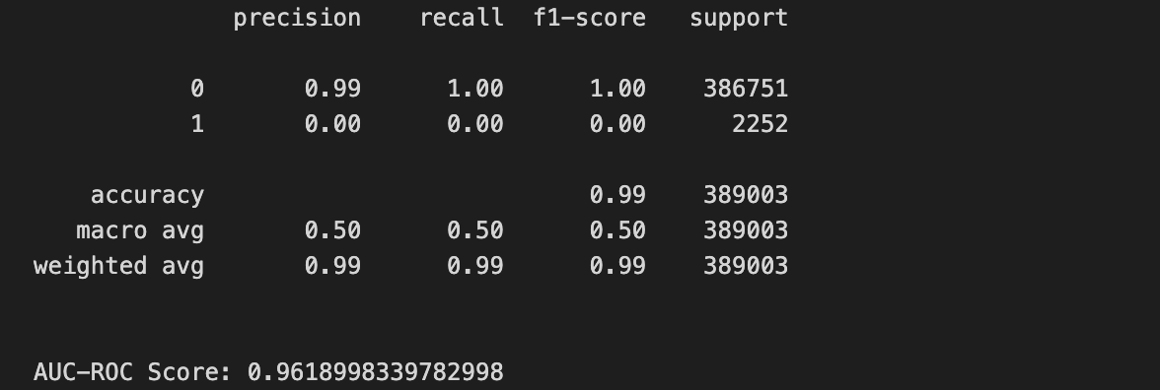
Data Modeling
Model Evaluation:

Slide 22

Thank you for listening

